Slide 1
Unit 4 I have big eyes

Slide 2
I have...句型操练

Slide 3
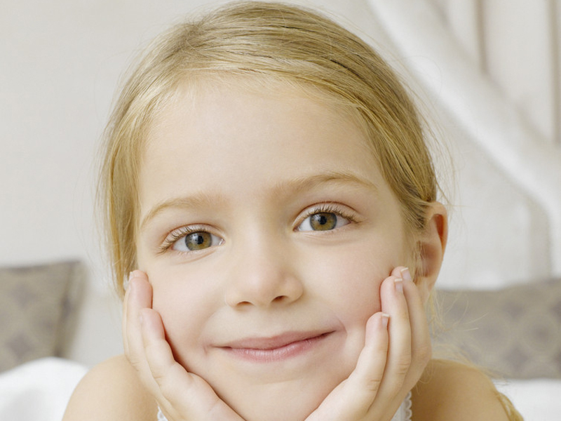
face

Slide 4
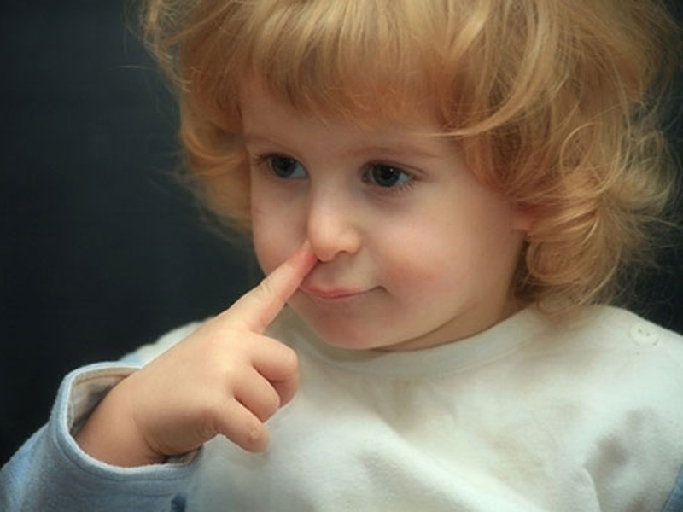
a nose
I have a big nose.

Slide 5
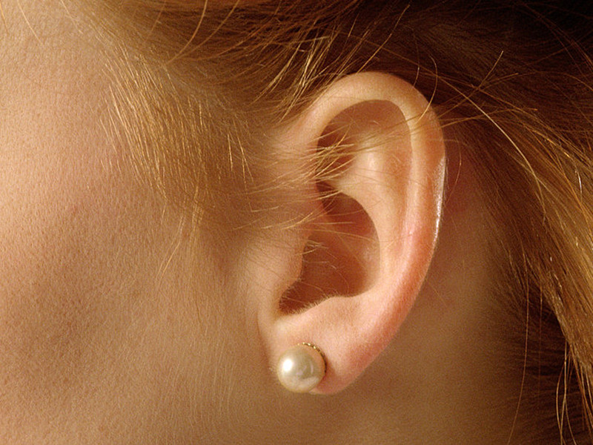
an ear
I have a big ear.

Slide 6
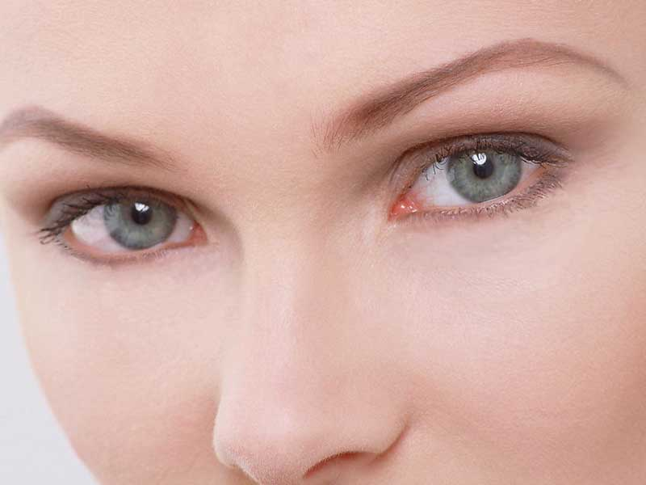
eyes
I have big eyes.

Slide 7
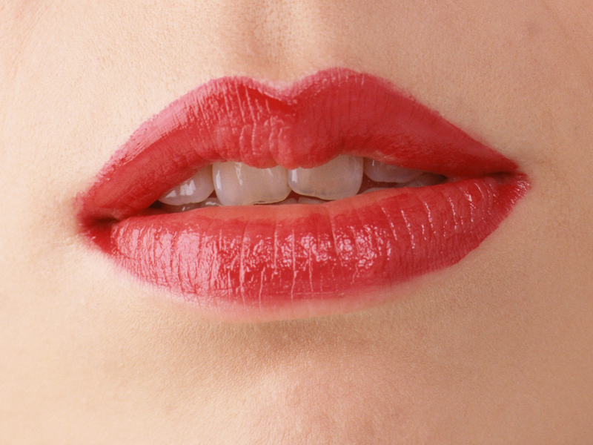
a mouth
I have a big mouth.

Slide 8
Practice
用英文和同桌说说你的脸上有哪些器官吧！
Look, I have…

Slide 9
Thank you!

